Slide 1
FHWA’s Freight Fluidity Program
Nicole Katsikides
Federal Highway Administration
Office of Freight Management and Operations

Slide 2
Importance of Analyzing Freight Fluidity
Provides understanding of multimodal, end to end flow of goods.
Identifies where bottlenecks are occurring and interrelationship with other modes/total supply chains.
Connects transportation and economic development discussions.
Illustrates the global, national and regional nature of freight infrastructure; encourage partnerships
Engages the private sector
Supports MAP-21 focus on freight
Supports Commerce, USACE, Agriculture, Energy and USDOT initiatives
Notes:
National
Support MAP-21
Use user perspective of freight to identify areas of greatest need
Support future freight programs (i.e. GROW AMERICA)
Develop or adjust programs to accommodate freight needs
State and Region
Understand the user perspective of freight
Identify bottlenecks and opportunities
Invest in areas of greatest need
Plan for improvements and growth

Slide 3
Fluidity Applications Throughout the U.S.
Federal
FHWA TRB workshop
FHWA/DOC/I-95 Analysis
North American Transportation Statistics Interchange
North American Fluidity System implementation
Regional, Corridor and State
Border crossing (Texas)
State-level (Maryland, Florida)
Metropolitan projects (Chicago)

Slide 4
Fluidity Examples

Slide 5
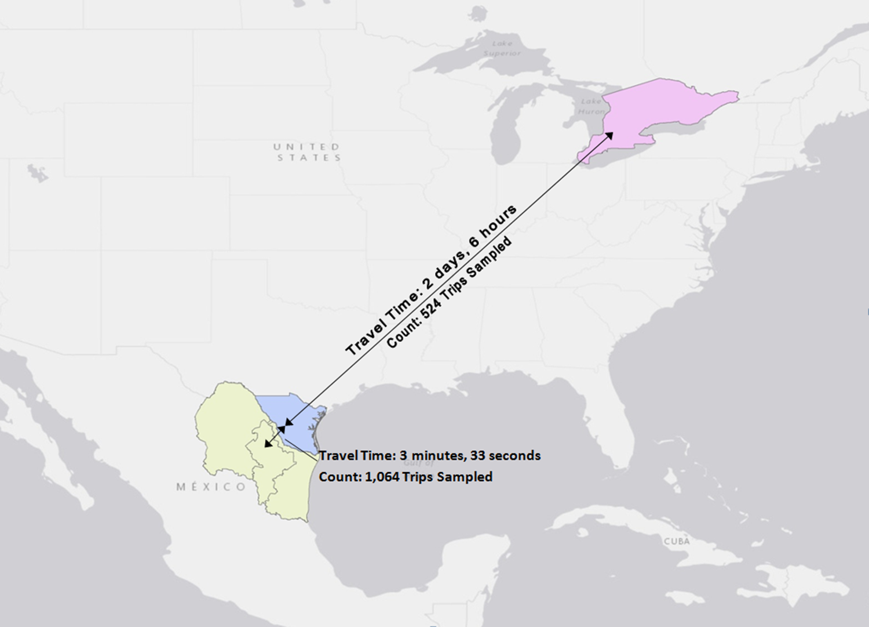
North American Fluidity Analysis: Automotive Supply Chain with Border Crossing

Slide 6
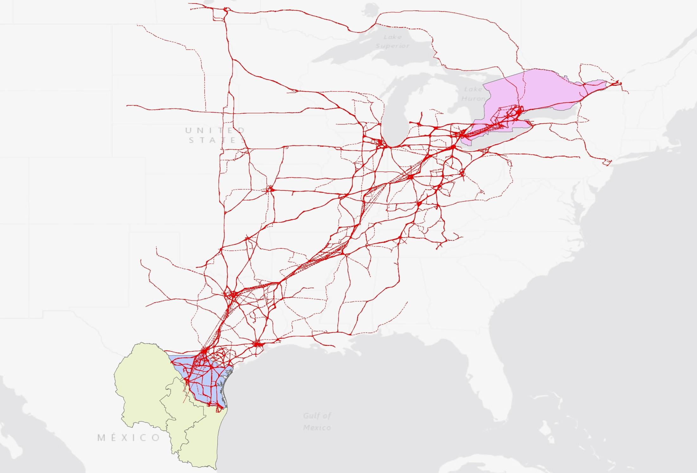
FHWA Probe Data Representation of the Same Automotive Supply Chain

Slide 7
Multimodal Supply Chain Case Studies
Autos – General Motors auto parts
From US and NAFTA suppliers to auto assembly plant in Tennessee
Retail – Target® consumer goods
From Ports of Los Angeles/Long Beach and Seattle/Tacoma via Chicago to metropolitan New York
Electronics – Panasonic electronics
Between manufacturing and assembly facilities in San Diego and Tijuana
Agriculture – Soybean exports
From Illinois farms to Louisiana port
Food – Perdue processed chicken
From DelMarVa region to Mid-Atlantic markets

Slide 8
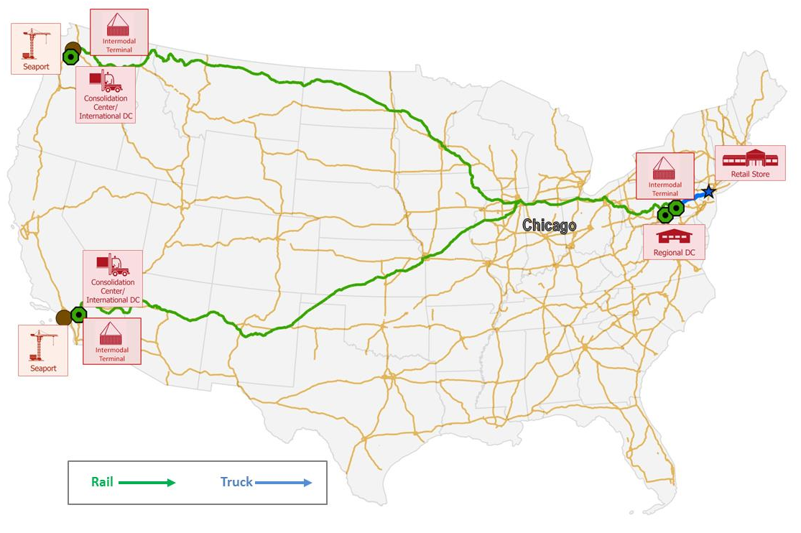
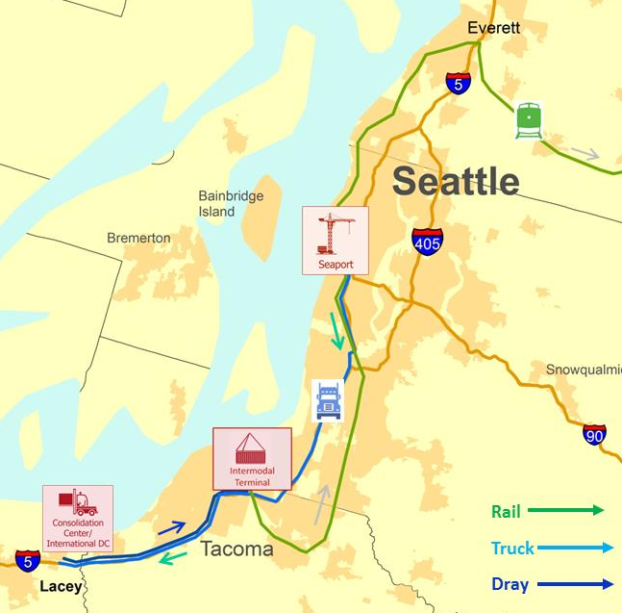
Case Example: Retail Supply Chain (Target)

Slide 9
Fluidity Next Steps
Implement U.S. and potential North America fluidity measurement program.
Work with partners on continued supply chain analysis, state and regional analyses.
Improve data and analytical options.

Slide 10
For More Information:
Nicole Katsikides, Freight Performance Measures Program Manager
nicole.katsikides@dot.gov
202-366-6993

